Slide 1
AssemblyViz
Report 1
Nikita, Robby, Yurda, and Maria

Slide 2
Project Overview
AssemblyViz - software for assembly code visualization.
Who is it for? Dr. Hammurabi Mendes (primary customer) and Computer Organization (CSC 250) students (users)
Core goal? Browser-based HYMN+RISC-V simulator
Novelty? RISC-V integration, memory visualization, and debugging

Slide 3
Customer Validation
Primary Customer: Dr. Hammurabi Mendes
Meeting 1 Validated program design and architecture
Meeting 2 Validated the implemented functionality (meets customer needs)
Key Feedback
Expressed satisfaction with design and functionality that visualizes HYMN and RISC-V assembly languages.
Reduces students' psychological resistance to assembly programming
Simulator correctly follows instruction set architecture (ISA) specifications.

Slide 4
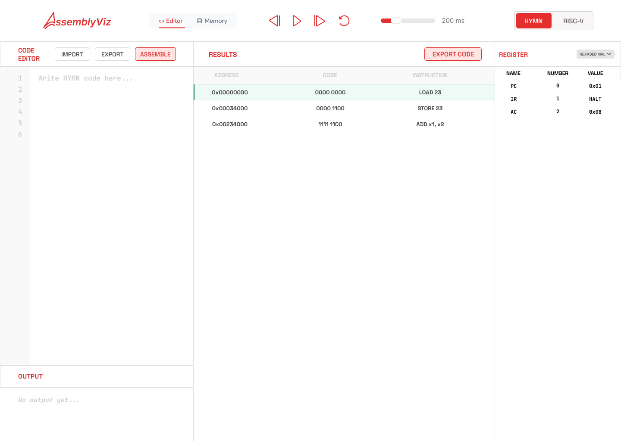
Sprint 1 Summary (2/3 - 2/18)
Designed Front-End
Navigation tool
Code editor
Register visualization
Results/Memory chart
Researched RISC-V and HYMN ISA manuals
RISC-V
HYMN
Implemented parser/assembler
Notes:
During the first sprint we did unit test for parser and implemented them in the next spring bc our main goal was to design a product, research, how they work and implement draft of parser and assembler

Slide 5
Sprint 2 Summary (2/18 - 3/20)
Fully-functional RISC-V ISA implementation
assembler.py
decoder.py,
isa.py
memory.py
registers.py
simulation.py
3. Shell of Front-End
Using HTML, CSS, and JavaScript
2. Fully functional HYMN ISA
implementation
instructions.py
machine.py
parser.py
executor.py
Notes:
Implemente dunit test,

Slide 6
Major Change 1
Original
Change
Collaborate for coding both HYMN and RISC-V back-end logic.
Merged both sprints so that implementation and testing occurred simultaneously.
Team-Driven: we can now link the front-end to both halves of our backend.

Slide 7
Major Change 2
Original
Change
Promised a React/TypeScript web app completed for Sprint 1.
Mainly focused on our backend logic and implementation for both HYMN and RISC-V instead of front-end functionality.
Team-Driven: we wanted to ensure maximum testing for both logics

Slide 8
Major Change 3
Original
Change
HYMN Parser iterates through code one time to collect 8-bit instructions.
HYMN Parser iterates through code two times: allocating memory for labels and second to parse correctly.
Technical-Driven: ensuring all labels are defined so that program addresses flags correctly.

Slide 9
Live Demo | HYMN
Current Workflow
Uses Sumn program as example from CSC 250 HW 4 in .S format
File the tests folder in the HYMN folder
Run the program using
python3 backend/hymn/tests/step_sumn.py
Observe the program’s output one iteration at a time
https://github.com/NikitaAleksii/AssemblyViz/tree/main/backend/hymn

Slide 10
Live Demo | RISC-V
Current Workflow
Write RISC-V assembly code into a file with .S format
Put the file into the /tests folder in the riscv parent folder
Edit simulation_test.py to suit the program’s functionality
Run the program using
python3 -m riscv.tests.simulation_test
Observe the program’s output
https://github.com/NikitaAleksii/AssemblyViz/tree/main/backend/riscv

Slide 11
Testing
Automated Unit Tests (Verification) Tests compare precomputed expected outputs against actual module output
RISC-V Modules covered: assembler.py, decoder.py, isa.py, memory.py, registers.py, simulation.py
HYMN Modules covered: debugger.py, executor.py, instructions.py, machine.py, parse.py
Acceptance Testing (Validation)
Confirmed correct behavior against RISC-V instruction set architecture (ISA) specification
Manual Test (Verification)
Interactive simulation testbench accepts any assembly input
Flexibility allowed us to catch and fix bugs

Slide 12
Challenges
Gap between working command line and a web app complexity
New front-end technologies (React and Typescript)
Self-modifying code
Coordinating back-end and front-end functionality
Coordinate meetings
Solutions
Moving meeting times each week to accommodate needs
Building our product in stages or phases (UI, features)

Slide 13

Plan for the Next Iteration
Migrate UI to React + TypeScript
Integrate frontend with backend (real execution)
Implement:
Memory visualization
Debugging (step/run)
Real register updates
Replace mock data with real outputs
Conduct usability testing (students + professor)
Sprint 3
Complete HYMN assembler
Memory history (in progress)
Registers (basic UI)
Debugger (mock UI)
Integrate into AssemblyViz browser-based UI (in progress)
New Goals
Frontend ↔ Backend integration
React + TypeScript migration
Replace mock data with real execution
Real register updates
UI polish & responsiveness
Notes:
We structured our next iteration around moving from a working prototype to a fully integrated application.
So far, we have two main parts: a working backend for both HYMN and RISC-V, and a frontend prototype.
The first priority is integration. We need to connect the frontend to the backend.
The second priority is migrating the frontend to React and TypeScript. Our current UI is built with HTML, CSS, and JavaScript as a fast prototype, but React will allow us to organize the interface into reusable components and scale the application more effectively.
Next, we will implement core visualization features. This includes memory visualization, step-by-step debugging, and real register updates based on execution.
Finally, we will conduct usability testing with students and our professor to evaluate how intuitive the interface is and how effectively it supports learning.

Slide 14
Sprint Review 1
Delivered
Revisited features
Customer Feedback
Initial HYMN and RISC-V parser and executor files and webpage design.
Existing HYMN software supports editing memory cells. We exclude from AssemblyViz
Dr. Mendes was happy with this sprint
Notes:
In Sprint 1, we focused on building the foundation of the project.
On the backend side, we developed the initial HYMN and RISC-V parser and executor logic.
On the frontend side, we created the initial webpage structure and interface design.
One feature we intentionally excluded was editing memory cells, since it is not essential to our core goal and could add unnecessary complexity.
Overall, the sprint was successful, and our primary customer, Dr. Mendes, was satisfied with the progress and direction.

Slide 15
Sprint Review 2
Delivered
Revisited features
Customer Feedback
Fully implemented HYMN and RISC-V backend logic
Completed HTML shell from original first sprint with visualization layer
Dr. Mendes was happy with this sprint
Notes:
In Sprint 2, we expanded significantly on the backend and frontend.
The backend logic for both HYMN and RISC-V was fully implemented.
On the frontend, we completed the HTML-based interface and added a visualization layer, including the code editor, results panel, and register display.
However, this frontend currently is not yet connected to the backend.
Despite that, this sprint was successful in creating a working prototype of the full system structure, and Dr. Mendes was again satisfied with the progress.

Slide 16
QUESTIONS?

